Slide 1
Crop Recommendation System: Data-Driven Agriculture A solution designed to provide farmers with personalized recommendations for crop selection based on data analysis and machine learning.
Hanin Essam Sayed Mohamed
Date: Nov - 2024

Slide 2
Project Overview
Notes:
Problem Statement:
Farmers often face challenges in selecting the most suitable crops for their specific conditions, which can lead to suboptimal yield and resource use.
Limited access to data-driven insights affects productivity, sustainability, and economic outcomes in agriculture.
Solution Overview:
Develop a Personalized Recommendation System that uses historical data, weather conditions, soil quality, and user interactions to suggest optimal crops.
Leverages recommendation models to tailor suggestions to individual farmers' needs.
Unique Value Proposition:
Data-Driven Insights: Unlike general agricultural advice, this system provides personalized recommendations based on real-time and historical data.
Advanced ML Techniques: By integrating both collaborative filtering and content-based approaches, the system offers accuracy and adaptability.
Scalability for Diverse Conditions: Suitable for diverse climates and soil types, making it versatile across different regions.

Slide 3

Problem Statement:
Precision agriculture is gaining importance to help farmers make informed decisions about crop selection. Currently, farmers often rely on traditional methods and general advice, which may not be suitable for their specific farm conditions. The lack of personalized recommendations leads to suboptimal crop yields and resource inefficiencies. Solution Overview:
Develop a Personalized Recommendation System that suggest optimal crops based on multiple features:
- historical data, weather conditions, soil quality, and user interactions to suggest optimal crops. - Leverages recommendation models to tailor suggestions to individual farmers' needs. Unique Value Proposition:
Data-Driven Insights
Advanced ML Techniques
Scalability for Diverse Conditions
Notes:
Problem Statement:
Farmers often face challenges in selecting the most suitable crops for their specific conditions, which can lead to suboptimal yield and resource use.
Limited access to data-driven insights affects productivity, sustainability, and economic outcomes in agriculture.
Solution Overview:
Develop a Personalized Recommendation System that uses historical data, weather conditions, soil quality, and user interactions to suggest optimal crops.
Leverages recommendation models to tailor suggestions to individual farmers' needs.
Unique Value Proposition:
Data-Driven Insights: Unlike general agricultural advice, this system provides personalized recommendations based on real-time and historical data.
Advanced ML Techniques: By integrating both collaborative filtering and content-based approaches, the system offers accuracy and adaptability.
Scalability for Diverse Conditions: Suitable for diverse climates and soil types, making it versatile across different regions.

Slide 4
PROJECT PIPLINE
Notes:
Problem Statement:
Farmers often face challenges in selecting the most suitable crops for their specific conditions, which can lead to suboptimal yield and resource use.
Limited access to data-driven insights affects productivity, sustainability, and economic outcomes in agriculture.
Solution Overview:
Develop a Personalized Recommendation System that uses historical data, weather conditions, soil quality, and user interactions to suggest optimal crops.
Leverages recommendation models to tailor suggestions to individual farmers' needs.
Unique Value Proposition:
Data-Driven Insights: Unlike general agricultural advice, this system provides personalized recommendations based on real-time and historical data.
Advanced ML Techniques: By integrating both collaborative filtering and content-based approaches, the system offers accuracy and adaptability.
Scalability for Diverse Conditions: Suitable for diverse climates and soil types, making it versatile across different regions.

Slide 5
Project Pipeline:
Data Collection – Retrieve crop dataset from Kaggle and organize it for analysis.
Data Preprocessing – Clean, encode, and scale data to prepare it for model training.
Model Development – Train and evaluate GAN and Random Forest models for recommendations.
Experiment Tracking – Use MLflow to monitor model performance and adjustments.
Model Deployment – Deploy the final model and integrate with the frontend for recommendations.
Notes:
Problem Statement:
Farmers often face challenges in selecting the most suitable crops for their specific conditions, which can lead to suboptimal yield and resource use.
Limited access to data-driven insights affects productivity, sustainability, and economic outcomes in agriculture.
Solution Overview:
Develop a Personalized Recommendation System that uses historical data, weather conditions, soil quality, and user interactions to suggest optimal crops.
Leverages recommendation models to tailor suggestions to individual farmers' needs.
Unique Value Proposition:
Data-Driven Insights: Unlike general agricultural advice, this system provides personalized recommendations based on real-time and historical data.
Advanced ML Techniques: By integrating both collaborative filtering and content-based approaches, the system offers accuracy and adaptability.
Scalability for Diverse Conditions: Suitable for diverse climates and soil types, making it versatile across different regions.

Slide 6
DATASET
Notes:
Problem Statement:
Farmers often face challenges in selecting the most suitable crops for their specific conditions, which can lead to suboptimal yield and resource use.
Limited access to data-driven insights affects productivity, sustainability, and economic outcomes in agriculture.
Solution Overview:
Develop a Personalized Recommendation System that uses historical data, weather conditions, soil quality, and user interactions to suggest optimal crops.
Leverages recommendation models to tailor suggestions to individual farmers' needs.
Unique Value Proposition:
Data-Driven Insights: Unlike general agricultural advice, this system provides personalized recommendations based on real-time and historical data.
Advanced ML Techniques: By integrating both collaborative filtering and content-based approaches, the system offers accuracy and adaptability.
Scalability for Diverse Conditions: Suitable for diverse climates and soil types, making it versatile across different regions.

Slide 7
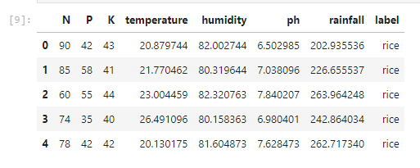
N: ratio of Nitrogen content in soil P (ratio of Phosphorous content in soil) - Important for energy transfer within the plant K (ratio of Potassium content in soil) - Plays a significant role in water regulation Temperature (temperature in degree Celsius)- Affects growth rate and metabolic processes. Different crops have optimal temperature ranges for best growth. Humidity (relative humidity in %) - Influences transpiration and disease prevalence. High humidity can encourage fungal growth, while low humidity increases water stress. pH (ph value of the soil)- Indicates soil acidity or alkalinity. Different plants thrive at different pH levels, as pH affects nutrient availability in the soil. Rainfall (in mm) - Critical for soil moisture levels and crop hydration, with each crop type having specific water needs for optimal growth.
Notes:
Problem Statement:
Farmers often face challenges in selecting the most suitable crops for their specific conditions, which can lead to suboptimal yield and resource use.
Limited access to data-driven insights affects productivity, sustainability, and economic outcomes in agriculture.
Solution Overview:
Develop a Personalized Recommendation System that uses historical data, weather conditions, soil quality, and user interactions to suggest optimal crops.
Leverages recommendation models to tailor suggestions to individual farmers' needs.
Unique Value Proposition:
Data-Driven Insights: Unlike general agricultural advice, this system provides personalized recommendations based on real-time and historical data.
Advanced ML Techniques: By integrating both collaborative filtering and content-based approaches, the system offers accuracy and adaptability.
Scalability for Diverse Conditions: Suitable for diverse climates and soil types, making it versatile across different regions.

Slide 8
EDA
Notes:
Problem Statement:
Farmers often face challenges in selecting the most suitable crops for their specific conditions, which can lead to suboptimal yield and resource use.
Limited access to data-driven insights affects productivity, sustainability, and economic outcomes in agriculture.
Solution Overview:
Develop a Personalized Recommendation System that uses historical data, weather conditions, soil quality, and user interactions to suggest optimal crops.
Leverages recommendation models to tailor suggestions to individual farmers' needs.
Unique Value Proposition:
Data-Driven Insights: Unlike general agricultural advice, this system provides personalized recommendations based on real-time and historical data.
Advanced ML Techniques: By integrating both collaborative filtering and content-based approaches, the system offers accuracy and adaptability.
Scalability for Diverse Conditions: Suitable for diverse climates and soil types, making it versatile across different regions.

Slide 9
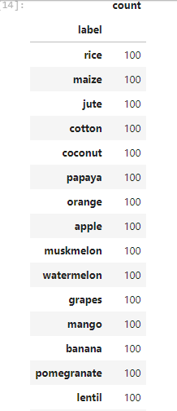
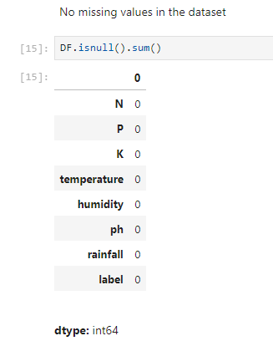
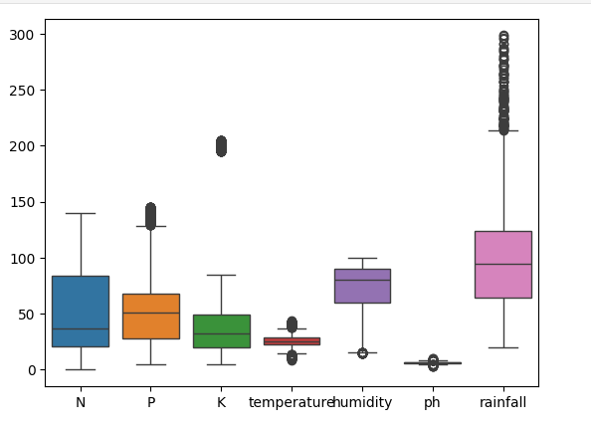
Dataset is Balanced
No Missing Values
Outliers
Notes:
Problem Statement:
Farmers often face challenges in selecting the most suitable crops for their specific conditions, which can lead to suboptimal yield and resource use.
Limited access to data-driven insights affects productivity, sustainability, and economic outcomes in agriculture.
Solution Overview:
Develop a Personalized Recommendation System that uses historical data, weather conditions, soil quality, and user interactions to suggest optimal crops.
Leverages recommendation models to tailor suggestions to individual farmers' needs.
Unique Value Proposition:
Data-Driven Insights: Unlike general agricultural advice, this system provides personalized recommendations based on real-time and historical data.
Advanced ML Techniques: By integrating both collaborative filtering and content-based approaches, the system offers accuracy and adaptability.
Scalability for Diverse Conditions: Suitable for diverse climates and soil types, making it versatile across different regions.

Slide 10
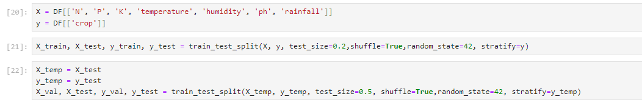
SPLITTING DATASET

Slide 11
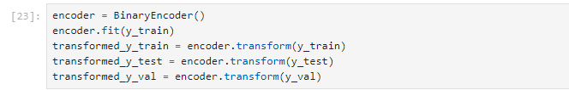
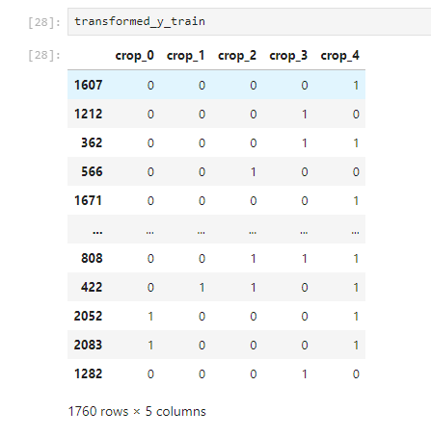
BINARY ENCODING

Slide 12
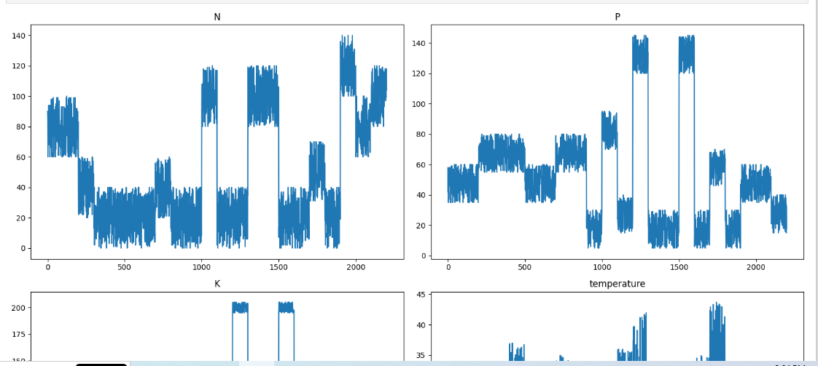
ROBUST SCALER
Before Scaling

Slide 13
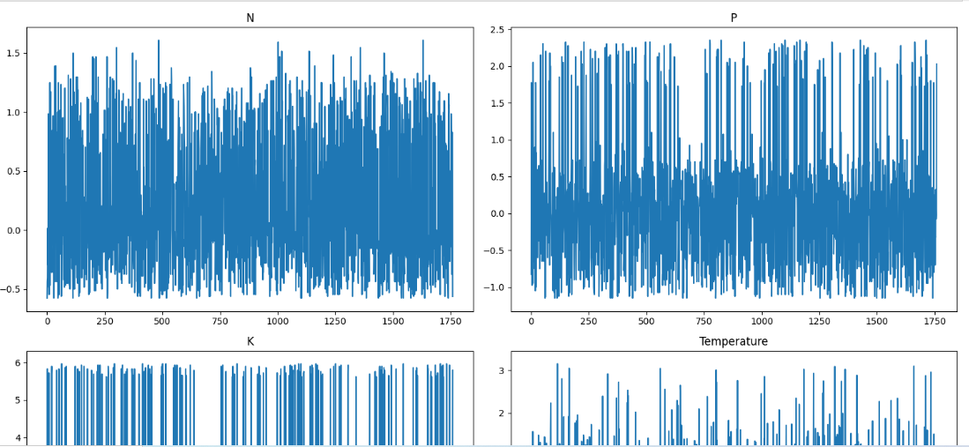
ROBUST SCALER
After Scaling

Slide 14
MODEL DEVELOPMENT
Notes:
Problem Statement:
Farmers often face challenges in selecting the most suitable crops for their specific conditions, which can lead to suboptimal yield and resource use.
Limited access to data-driven insights affects productivity, sustainability, and economic outcomes in agriculture.
Solution Overview:
Develop a Personalized Recommendation System that uses historical data, weather conditions, soil quality, and user interactions to suggest optimal crops.
Leverages recommendation models to tailor suggestions to individual farmers' needs.
Unique Value Proposition:
Data-Driven Insights: Unlike general agricultural advice, this system provides personalized recommendations based on real-time and historical data.
Advanced ML Techniques: By integrating both collaborative filtering and content-based approaches, the system offers accuracy and adaptability.
Scalability for Diverse Conditions: Suitable for diverse climates and soil types, making it versatile across different regions.

Slide 15
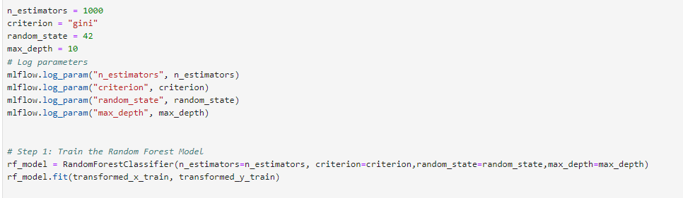
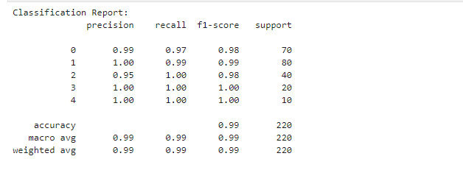
Random Forest Model

Slide 16
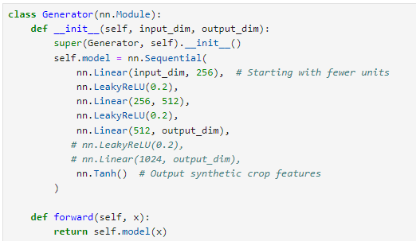
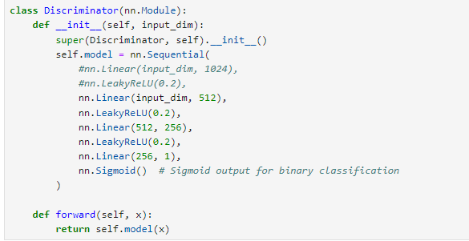
GAN

Slide 17
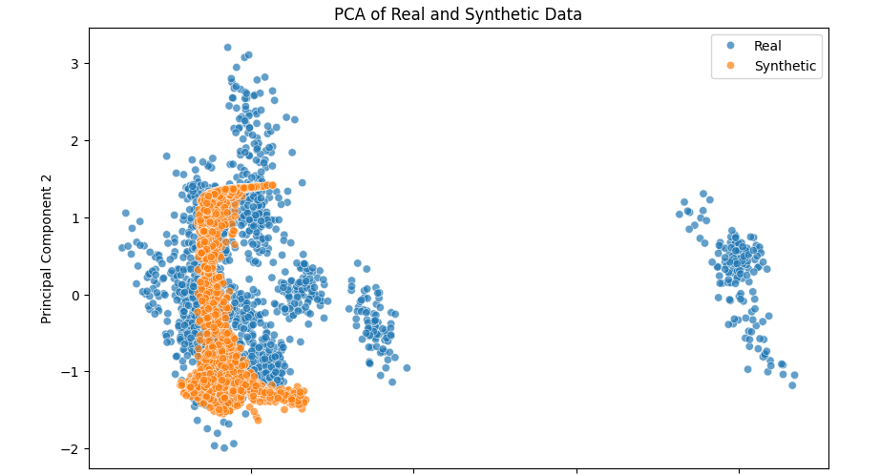
GAN

Slide 18
EXPERIMENT TRACKING
Notes:
Problem Statement:
Farmers often face challenges in selecting the most suitable crops for their specific conditions, which can lead to suboptimal yield and resource use.
Limited access to data-driven insights affects productivity, sustainability, and economic outcomes in agriculture.
Solution Overview:
Develop a Personalized Recommendation System that uses historical data, weather conditions, soil quality, and user interactions to suggest optimal crops.
Leverages recommendation models to tailor suggestions to individual farmers' needs.
Unique Value Proposition:
Data-Driven Insights: Unlike general agricultural advice, this system provides personalized recommendations based on real-time and historical data.
Advanced ML Techniques: By integrating both collaborative filtering and content-based approaches, the system offers accuracy and adaptability.
Scalability for Diverse Conditions: Suitable for diverse climates and soil types, making it versatile across different regions.

Slide 19
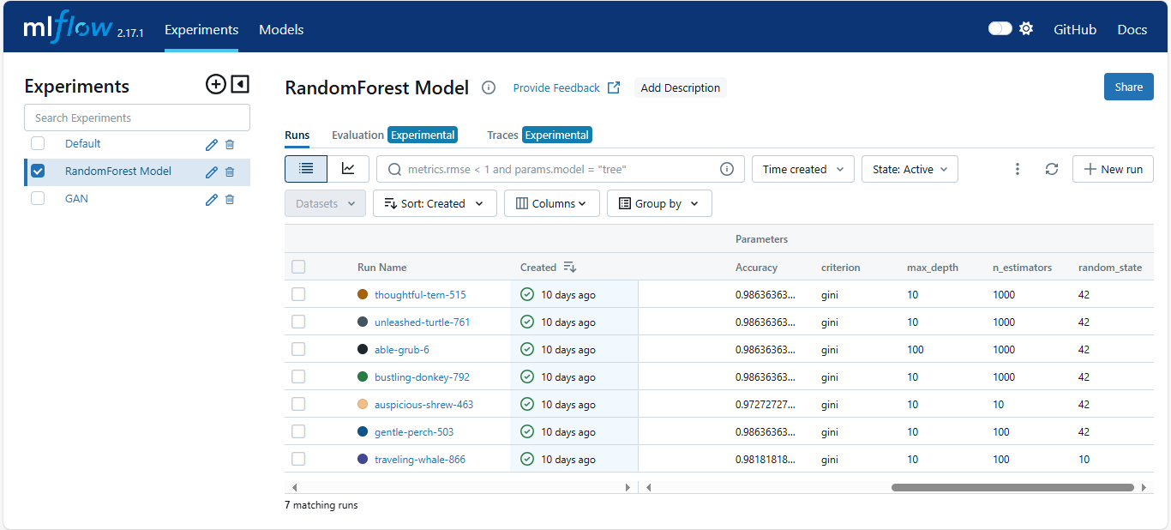
RANDOMFOREST MODEL

Slide 20
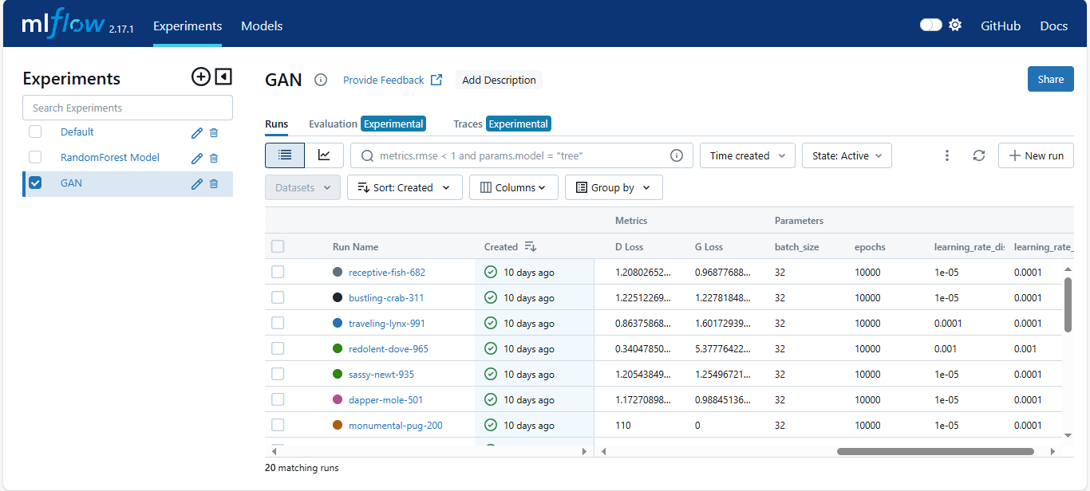
GAN

Slide 21
MODEL DEPLOYMENT
Notes:
Problem Statement:
Farmers often face challenges in selecting the most suitable crops for their specific conditions, which can lead to suboptimal yield and resource use.
Limited access to data-driven insights affects productivity, sustainability, and economic outcomes in agriculture.
Solution Overview:
Develop a Personalized Recommendation System that uses historical data, weather conditions, soil quality, and user interactions to suggest optimal crops.
Leverages recommendation models to tailor suggestions to individual farmers' needs.
Unique Value Proposition:
Data-Driven Insights: Unlike general agricultural advice, this system provides personalized recommendations based on real-time and historical data.
Advanced ML Techniques: By integrating both collaborative filtering and content-based approaches, the system offers accuracy and adaptability.
Scalability for Diverse Conditions: Suitable for diverse climates and soil types, making it versatile across different regions.

Slide 22
GAN

Slide 23
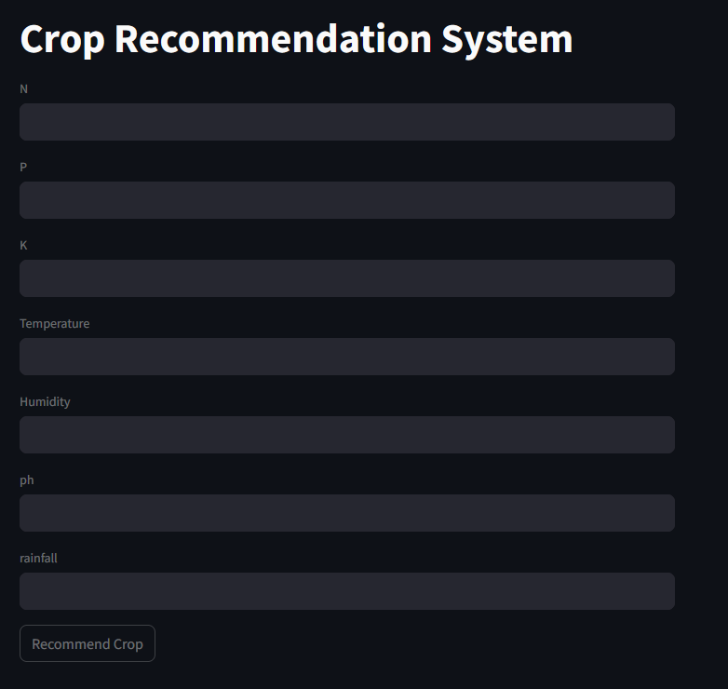
Crop Recommendation System UI N: ratio of Nitrogen content in soil P (ratio of Phosphorous content in soil) K (ratio of Potassium content in soil) Temperature (temperature in degree Celsius Humidity (relative humidity in %) pH (ph value of the soil) Rainfall (in mm) DEPLOYED ON STREAMLIT

Slide 24
End Users + Features
Notes:
Problem Statement:
Farmers often face challenges in selecting the most suitable crops for their specific conditions, which can lead to suboptimal yield and resource use.
Limited access to data-driven insights affects productivity, sustainability, and economic outcomes in agriculture.
Solution Overview:
Develop a Personalized Recommendation System that uses historical data, weather conditions, soil quality, and user interactions to suggest optimal crops.
Leverages recommendation models to tailor suggestions to individual farmers' needs.
Unique Value Proposition:
Data-Driven Insights: Unlike general agricultural advice, this system provides personalized recommendations based on real-time and historical data.
Advanced ML Techniques: By integrating both collaborative filtering and content-based approaches, the system offers accuracy and adaptability.
Scalability for Diverse Conditions: Suitable for diverse climates and soil types, making it versatile across different regions.

Slide 25
Primary User Personas: Future Key Features and Their Impact: Data Analytics and Reporting User Needs: In-depth insights into soil health, crop performance, and climate trends. Problem Solved: Empowers farmers and consultants to make informed decisions, enhancing crop yields and sustainability through data-driven strategies. Collaborative Tools User Needs: Efficient sharing of data and recommendations among farmers, consultants, and educational institutions. Problem Solved: Facilitates communication and knowledge sharing, enabling collaborative efforts in crop management and education. Mobile Accessibility User Needs: Access to recommendations and data while on the field or during farm activities. Problem Solved: Ensures that farmers and consultants can stay connected to real-time insights and recommendations, enhancing responsiveness and management capabilities.
Farmers – Individuals seeking tailored crop recommendations based on their soil and environmental conditions to optimize yields.
Agricultural Consultants – Professionals aiming to provide data-driven advice to farmers for crop selection and management practices.
Educational Institutions – Organizations looking to educate students and communities about sustainable agriculture practices and crop optimization.
Notes:
Problem Statement:
Farmers often face challenges in selecting the most suitable crops for their specific conditions, which can lead to suboptimal yield and resource use.
Limited access to data-driven insights affects productivity, sustainability, and economic outcomes in agriculture.
Solution Overview:
Develop a Personalized Recommendation System that uses historical data, weather conditions, soil quality, and user interactions to suggest optimal crops.
Leverages recommendation models to tailor suggestions to individual farmers' needs.
Unique Value Proposition:
Data-Driven Insights: Unlike general agricultural advice, this system provides personalized recommendations based on real-time and historical data.
Advanced ML Techniques: By integrating both collaborative filtering and content-based approaches, the system offers accuracy and adaptability.
Scalability for Diverse Conditions: Suitable for diverse climates and soil types, making it versatile across different regions.

Slide 26
Data Structure
Notes:
Problem Statement:
Farmers often face challenges in selecting the most suitable crops for their specific conditions, which can lead to suboptimal yield and resource use.
Limited access to data-driven insights affects productivity, sustainability, and economic outcomes in agriculture.
Solution Overview:
Develop a Personalized Recommendation System that uses historical data, weather conditions, soil quality, and user interactions to suggest optimal crops.
Leverages recommendation models to tailor suggestions to individual farmers' needs.
Unique Value Proposition:
Data-Driven Insights: Unlike general agricultural advice, this system provides personalized recommendations based on real-time and historical data.
Advanced ML Techniques: By integrating both collaborative filtering and content-based approaches, the system offers accuracy and adaptability.
Scalability for Diverse Conditions: Suitable for diverse climates and soil types, making it versatile across different regions.

Slide 27
Data Structure Database Architecture: Type: Using CSV File. Key Entities and Relationships: - Soil Nutrients – Columns include N, P, K (Nitrogen, Phosphorus, Potassium). - Environmental Factors – Columns include Temperature, Humidity, and Rainfall. - Soil Condition – Column pH reflects soil acidity/alkalinity. - Relationships: Each crop’s recommended nutrient profile relates directly to environmental factors and soil conditions. Data is aggregated per crop type, allowing recommendations based on historical and climate data. Data Flow: - Data Collection Source: Kaggle dataset Crop Recommendation Dataset. - Data Characteristics: - Columns: N, P, K, Temperature, Humidity, pH, Rainfall. - Shape: [e.g., 2200 rows x 7 columns]. - Balance: The dataset is [balanced] for different crop types, ensuring varied but comprehensive recommendations. Data Storage and Access: - Storage: CSV format - Access: Machine learning models retrieve data for training, testing, and recommendation generation. Techniques: - Feature Scaling: Normalize temperature, humidity, pH, and nutrient levels. - Preprocessing: Address any null values and adjust imbalanced data if necessary.
Notes:
Problem Statement:
Farmers often face challenges in selecting the most suitable crops for their specific conditions, which can lead to suboptimal yield and resource use.
Limited access to data-driven insights affects productivity, sustainability, and economic outcomes in agriculture.
Solution Overview:
Develop a Personalized Recommendation System that uses historical data, weather conditions, soil quality, and user interactions to suggest optimal crops.
Leverages recommendation models to tailor suggestions to individual farmers' needs.
Unique Value Proposition:
Data-Driven Insights: Unlike general agricultural advice, this system provides personalized recommendations based on real-time and historical data.
Advanced ML Techniques: By integrating both collaborative filtering and content-based approaches, the system offers accuracy and adaptability.
Scalability for Diverse Conditions: Suitable for diverse climates and soil types, making it versatile across different regions.

Slide 28
Programming Languages & Frameworks
Notes:
Problem Statement:
Farmers often face challenges in selecting the most suitable crops for their specific conditions, which can lead to suboptimal yield and resource use.
Limited access to data-driven insights affects productivity, sustainability, and economic outcomes in agriculture.
Solution Overview:
Develop a Personalized Recommendation System that uses historical data, weather conditions, soil quality, and user interactions to suggest optimal crops.
Leverages recommendation models to tailor suggestions to individual farmers' needs.
Unique Value Proposition:
Data-Driven Insights: Unlike general agricultural advice, this system provides personalized recommendations based on real-time and historical data.
Advanced ML Techniques: By integrating both collaborative filtering and content-based approaches, the system offers accuracy and adaptability.
Scalability for Diverse Conditions: Suitable for diverse climates and soil types, making it versatile across different regions.

Slide 29
Main Programming Languages:
Python – Primary language for data analysis, machine learning, and model building.
Torch – Used for model development and deep learning.
Frameworks and Tools:
GANs (Generative Adversarial Networks) – For creating synthetic data to enhance model training.
Google Colab/Jupyter Notebook – Cloud-based platform for code execution and model training.
MLflow – Tracking and managing machine learning experiments.
Streamlit – Building an interactive front end for model deployment and user interaction.
Libraries:
Data Manipulation: numpy, pandas
Data Visualization: matplotlib, seaborn
Encoding and Scaling: category_encoders (BinaryEncoder), sklearn.preprocessing (RobustScaler)
Machine Learning: sklearn (RandomForestClassifier, model evaluation metrics)
Deep Learning: tensorflow, torch (with modules like torch.nn, torch.optim)
Recommender System (optional): cosine_similarity, surprise (SVD for collaborative filtering)
Supporting Technologies:
Cloud Platform – Google Colab acts as the cloud environment for collaborative work and large model computations.
Notes:
Problem Statement:
Farmers often face challenges in selecting the most suitable crops for their specific conditions, which can lead to suboptimal yield and resource use.
Limited access to data-driven insights affects productivity, sustainability, and economic outcomes in agriculture.
Solution Overview:
Develop a Personalized Recommendation System that uses historical data, weather conditions, soil quality, and user interactions to suggest optimal crops.
Leverages recommendation models to tailor suggestions to individual farmers' needs.
Unique Value Proposition:
Data-Driven Insights: Unlike general agricultural advice, this system provides personalized recommendations based on real-time and historical data.
Advanced ML Techniques: By integrating both collaborative filtering and content-based approaches, the system offers accuracy and adaptability.
Scalability for Diverse Conditions: Suitable for diverse climates and soil types, making it versatile across different regions.

Slide 30
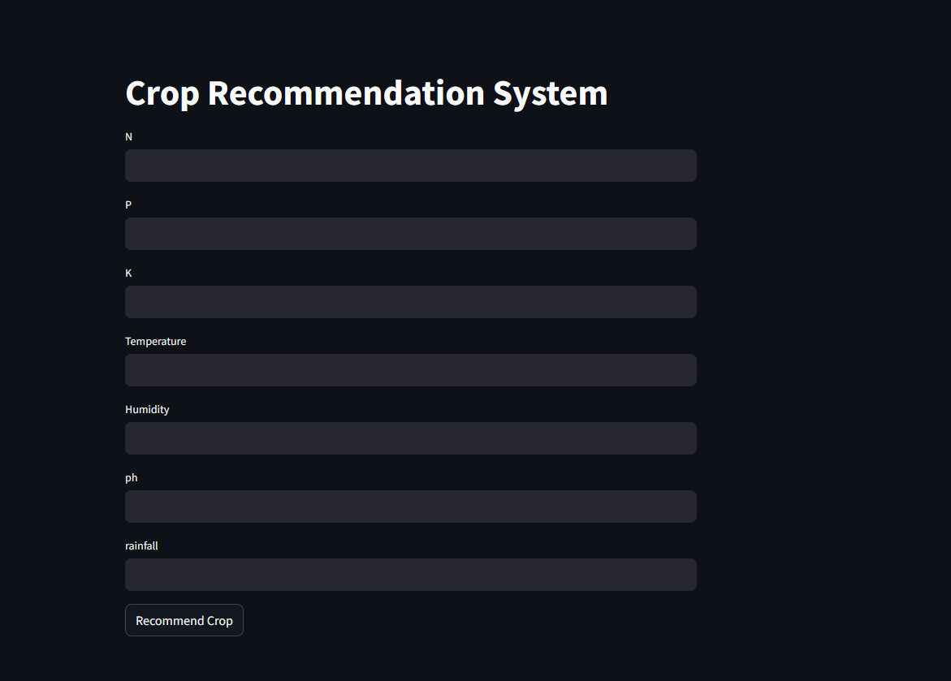
Live Application

Slide 31
Project Team & Roles
Name | Role
Abdelrahman Osama Mohamed Nabih | Week 1: Data Collection and Preprocessing
Abdelrhman Walaa Hussein | Week 2: ML and Recommendation Modeling
Hanin Essam Sayed Mohamed | Week 3: Advanced Techniques Refine ML GANs Deployment
Mostafa Mohamed Youssef | Week 4: MLOps Reviewing code Final Presentation Test deployment
Notes:
Problem Statement:
Farmers often face challenges in selecting the most suitable crops for their specific conditions, which can lead to suboptimal yield and resource use.
Limited access to data-driven insights affects productivity, sustainability, and economic outcomes in agriculture.
Solution Overview:
Develop a Personalized Recommendation System that uses historical data, weather conditions, soil quality, and user interactions to suggest optimal crops.
Leverages recommendation models to tailor suggestions to individual farmers' needs.
Unique Value Proposition:
Data-Driven Insights: Unlike general agricultural advice, this system provides personalized recommendations based on real-time and historical data.
Advanced ML Techniques: By integrating both collaborative filtering and content-based approaches, the system offers accuracy and adaptability.
Scalability for Diverse Conditions: Suitable for diverse climates and soil types, making it versatile across different regions.

Slide 32
Project Team & Roles cont’d
Project Pipeline:
Week 1-2: Data Collection and Preprocessing
Week 3-4: Model Development and Experiment Tracking
Week 5: Model Deployment and Testing
Week 6: Adjustments, Presentation and Project Completion
Notes:
Problem Statement:
Farmers often face challenges in selecting the most suitable crops for their specific conditions, which can lead to suboptimal yield and resource use.
Limited access to data-driven insights affects productivity, sustainability, and economic outcomes in agriculture.
Solution Overview:
Develop a Personalized Recommendation System that uses historical data, weather conditions, soil quality, and user interactions to suggest optimal crops.
Leverages recommendation models to tailor suggestions to individual farmers' needs.
Unique Value Proposition:
Data-Driven Insights: Unlike general agricultural advice, this system provides personalized recommendations based on real-time and historical data.
Advanced ML Techniques: By integrating both collaborative filtering and content-based approaches, the system offers accuracy and adaptability.
Scalability for Diverse Conditions: Suitable for diverse climates and soil types, making it versatile across different regions.

Slide 33
Thank YOU!
Any Questions?
Reach out to the team:
he106400@gmail.com
moustafa.youssuf@gmail.com
abdelrahmanosama@aucegypt.edu
abdelrahmanwalaa96@gmail.com
Notes:
Problem Statement:
Farmers often face challenges in selecting the most suitable crops for their specific conditions, which can lead to suboptimal yield and resource use.
Limited access to data-driven insights affects productivity, sustainability, and economic outcomes in agriculture.
Solution Overview:
Develop a Personalized Recommendation System that uses historical data, weather conditions, soil quality, and user interactions to suggest optimal crops.
Leverages recommendation models to tailor suggestions to individual farmers' needs.
Unique Value Proposition:
Data-Driven Insights: Unlike general agricultural advice, this system provides personalized recommendations based on real-time and historical data.
Advanced ML Techniques: By integrating both collaborative filtering and content-based approaches, the system offers accuracy and adaptability.
Scalability for Diverse Conditions: Suitable for diverse climates and soil types, making it versatile across different regions.

